Slide 1
NULL Values in SQL

Slide 2
NULL Values in SQL
In the world of databases, data is everything, but not all data is created equal.
A fundamental concept in the management and manipulation of data is understanding the importance and role of NULL values.
NULL is a special marker used in Structured Query Language (SQL) to indicate that a data value does not exist in the database.
It could mean that the data is unknown, unavailable, or not applicable.
Understanding NULL values is crucial in designing databases, writing SQL queries, or performing data analysis.
The correct interpretation and management of these NULL values will ensure the accuracy and efficiency of your data operations.

Slide 3
Understanding NULL in SQL
In SQL, NULL signifies the absence of information or a missing value. This is different from a zero value or a field that contains spaces.
A NULL value is a field with no value; it is not equivalent to zero or a space, which are actual values.
It's crucial to recognize that NULL is not data—it represents a lack of data.
Consider the following example, where we have a table named "Students", and one of the students hasn't been assigned a grade yet.
Here, Jack Doe's grade isn't available, which is why it's marked as NULL. This NULL represents that we don't have a grade for Jack at the moment.
Student_ID | Student_Name | Grade
1 | John Doe | A
2 | Jane Doe | B
3 | Jack Doe | NULL

Slide 4
Handling NULL Values in SQL
When handling data in SQL, NULL values might present some challenges because any operation on NULL yields NULL.
This behavior can lead to unexpected results if not carefully managed.
SQL provides some handy ways to handle NULL values. You can use the IS NULL and IS NOT NULL operators to check for NULL values.
Here is a simple query to find all students who haven't been assigned a grade yet:
SELECT * FROM Students
WHERE Grade IS NULL;
Similarly, you can select the students who have been assigned a grade using IS NOT NULL:
SELECT * FROM Students WHERE Grade IS NOT NULL;

Slide 5
NULL Values in SQL Functions
Different SQL functions handle NULL values differently.
Functions like COUNT(), SUM(), and AVG() ignore NULL values, whereas others like CONCAT() handle NULL in their own ways.
For example, COUNT(column) ignores NULL values while counting, but COUNT(*) counts rows including NULL. So be careful while using these functions as it might result in unexpected output.
SELECT COUNT(Grade) FROM Students;
SELECT COUNT(*) FROM Students;
The first query will give us the number of students who have been assigned a grade (excluding NULLs), whereas the second query will give us the total number of students (including NULLs).

Slide 6
SQL NULL Functions
SQL provides a few functions to deal specifically with NULL values: ISNULL() and NULLIF().
ISNULL() is a SQL Server function that lets you replace NULL values with a specified value. It takes two arguments, where it checks if the first one is NULL, and if it is, it returns the second argument. If not, it returns the first argument.
SELECT Student_Name, ISNULL(Grade, 'No Grade') AS Grade
FROM Students;
In this query, ISNULL checks if the Grade is NULL, and if it is, it replaces it with 'No Grade'. So, instead of displaying NULL, it would display 'No Grade'.

Slide 7
The NULLIF() function compares two expressions and returns NULL if they're equal; if they aren't, it returns the first expression.
SELECT Student_Name, NULLIF(Grade, 'F') AS Grade
FROM Students;
In this case, the NULLIF() function will return NULL if a student's grade is 'F'; otherwise, it will return the grade. This is useful in situations where you want to treat certain non-null values as null.

Slide 8
Different Types of SQL Keys
SQL Keys
SQL Key is a single or combination of multiple fields in a table. It is used to fetch or retrieve records/data rows from the data table according to the condition/requirement.
Keys are also used to create a relationship among different database tables or views.

Slide 9
What is a key in SQL?
In SQL, the different types of keys are the set of attributes used to identify a specific row from a table and to find or create the relation between two or more tables.
For example, the keys identify the rows by combining one or more sets of columns.
SQL provides different types of keys such as super key, candidate key, etc.
Generally, all the SQL keys use constraints to uniquely identify the rows from the larger set of datasets.

Slide 10

Types of SQL Keys

Slide 11
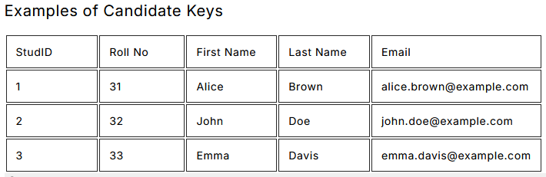
1. Candidate Key
A Candidate Key is a set of one or more fields/columns that can identify a record uniquely in a table.
There can be multiple Candidate Keys in one table. Each Candidate Key can work as a Primary Key.
The value for the Candidate key is always unique and non-null for all the tuples types. One thing to be remembered is that every table has to have at least one Candidate key, but there can be more than one candidate key can be there in a table. It is a super key with no repeated data is called a candidate key.
Example

Slide 12
2. Primary Key
A primary key is a set of one or more fields/columns of a table that uniquely identify a record in a database table. It can not accept null, or duplicate values.
Only one Candidate Key can be the Primary Key.
Out of all the candidate keys that can be possible or created for the specific table, there should be only one key that can be used to retrieve unique tuples from the table.
It is a thumb rule that there can be one Primary key that should be there for a table.
It can identify only one tuple (a record) at a time.
Example
Emp_Id is the primary key for relation Employee.

Slide 13

3. Super Key
A super key is a set of one or more than one key that can be used to identify a record uniquely in a table. Example: Primary key, Unique key, and Alternate key are a subset of Super Keys.
Super Key can contain multiple attributes that might not be able to identify tuples in a table independently, but when grouped with certain keys, they can identify tuples uniquely. It supports NULL values.
Adding zero or more attributes to the candidate key generates the super key. Example
Emp_Id + Mobile_No is a super key.
A candidate key is a super key but vice versa is not true.

Slide 14
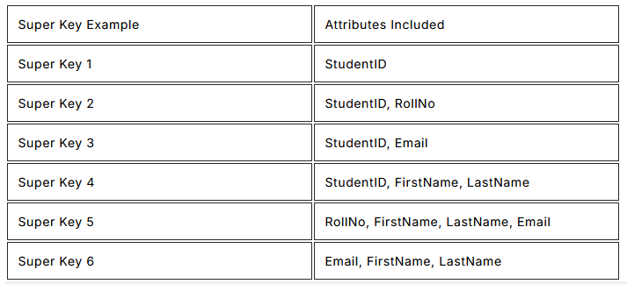
Super Key is the superset of a candidate key (explained below). The Primary Key of a table is picked from the super key set to be made the table’s identity attribute.
Examples of Super Keys
Here is a table with examples of super keys in a relational database context. Assume we have a table named Students with the following attributes: StudentID, RollNo, FirstName, LastName, and Email.

Slide 15
4. Alternate key
An Alternate key is a key that can work as a primary key. It is a candidate key that currently is not a primary key. It is also called a secondary key.
In other words, the alternate key is a column or collection of columns in a table that can uniquely identify each row in that table.
Every table of the database table can have multiple options for a primary key to be configured but out of them, only one column can be set as the primary key.
All the keys which are not primary keys are called the alternate keys of that table.
This secondary assurance becomes crucial when dealing with scenarios where the primary key might not be feasible due to complexity, length, or other considerations.
Example
In the Employee relation, Emp_Id, as well as Mobile_No both, are candidate keys but Mobile_No will be an alternate key (only one out of many candidate keys)
Practically in the database, we have only three types of keys Primary Key, Unique Key, and Foreign Key. Other types of keys are the only concepts of RDBMS that you should know.

Slide 16
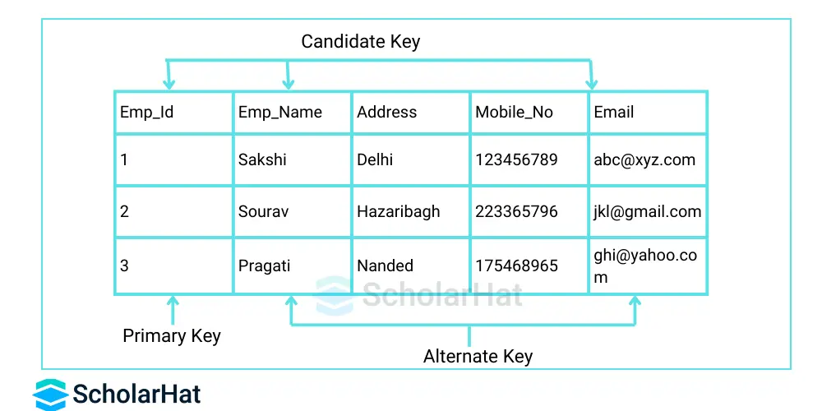

Slide 17
5. Composite/Compound Key
A composite Key is a combination of more than one field/column of a table. It can be a Candidate key or a primary key.
It gets its importance when it's not possible for a single column/attribute to uniquely identify all the records of a table. It acts as a primary key if there is no primary key in a table.
To create a composite key, you need to define multiple columns as primary or unique. This intertwining of attributes forms a robust identifier that prevents identical combinations from surfacing.

Slide 18
6. Unique Key
Unique Key can be a column or set of columns that can be used to uniquely identify the tuple from the database. One or more fields can be declared as a unique Key.
The unique Key column can also hold the NULL value. The use of unique keys improves the performance of data retrieval. It makes searching for records from the database much faster & efficient.
Example
In the Employee relation, a Unique Key could be applied to the email column, allowing null values to be present while maintaining the uniqueness requirement for non-null entries.

Slide 19
7. Foreign Key
A foreign key is an attribute that is a Primary key in its parent table but is included as an attribute in another host table.
The relation that is being referenced is called the referenced relation and the corresponding attribute is called the referenced attribute.
The relation that refers to the referenced relation is called a referencing relation and the corresponding attribute is called a referencing attribute.
The referenced attribute of the referenced relation should be the primary key to it.
Foreign Key may have duplicate & NULL values if it is defined to accept NULL values.
Example
Emp_Id in the Department table is a foreign key to Emp_Id in Employee relation.

Slide 20
--Department Table
CREATE TABLE Department
(
DeptID int PRIMARY KEY, --primary key
Name varchar (50) NOT NULL,
Address varchar (200) NOT NULL
)
--Student Table
CREATE TABLE Student
(
ID int PRIMARY KEY, --primary key
RollNo varchar(10) NOT NULL,
Name varchar(50) NOT NULL,
EnrollNo varchar(50) UNIQUE, --unique key
Address varchar(200) NOT NULL,
DeptID int FOREIGN KEY REFERENCES Department(DeptID) --foreign key
)

